Slide 1
B I T F E S T 2 0 2 5
BUET_NOT_LAST_DANCE
KUET CSE NATIONAL FEST
J A N U A R Y 0 4 , 2 0 2 5

Slide 2

Matching Resume to Job Description
Regression Problem

Slide 3

Problem Statement
Using a dataset of job descriptions, resumes, and corresponding matching scores, we train a model to predict compatibility between job descriptions and resumes in the test set.

Slide 4


Dataset Overview
Key Features :
Personal & Career Information
address, career_objective, skills
Total Rows :
7635
Educational Background
educational_institution_name, degree_names, passing_years
Professional Experience
professional_company_names, start_dates, end_dates
Extra-curricular Activities
Total Columns : 35
extra_curricular_activity_types, role_positions
Certifications and Languages
certification_skills, languages, proficiency_levels

Slide 5
Dataset Overview
Target Variable :
Total Rows :
7635
Correspondence between job description and resume
matched_score
Total Columns : 35

Slide 6
Dataset Analysis

Slide 7
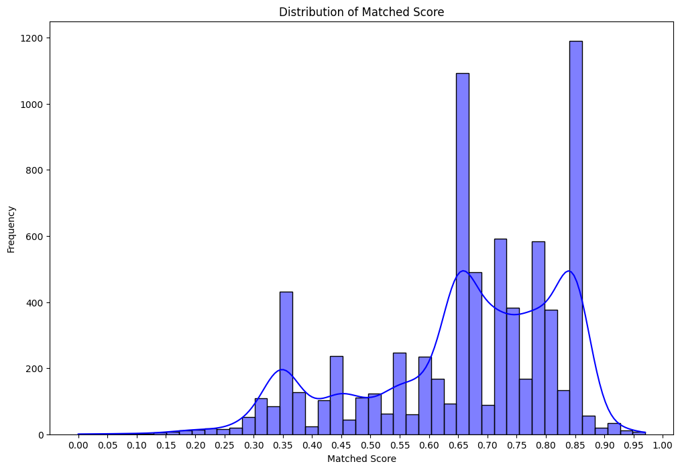
Distribution of
matched_score

Slide 8
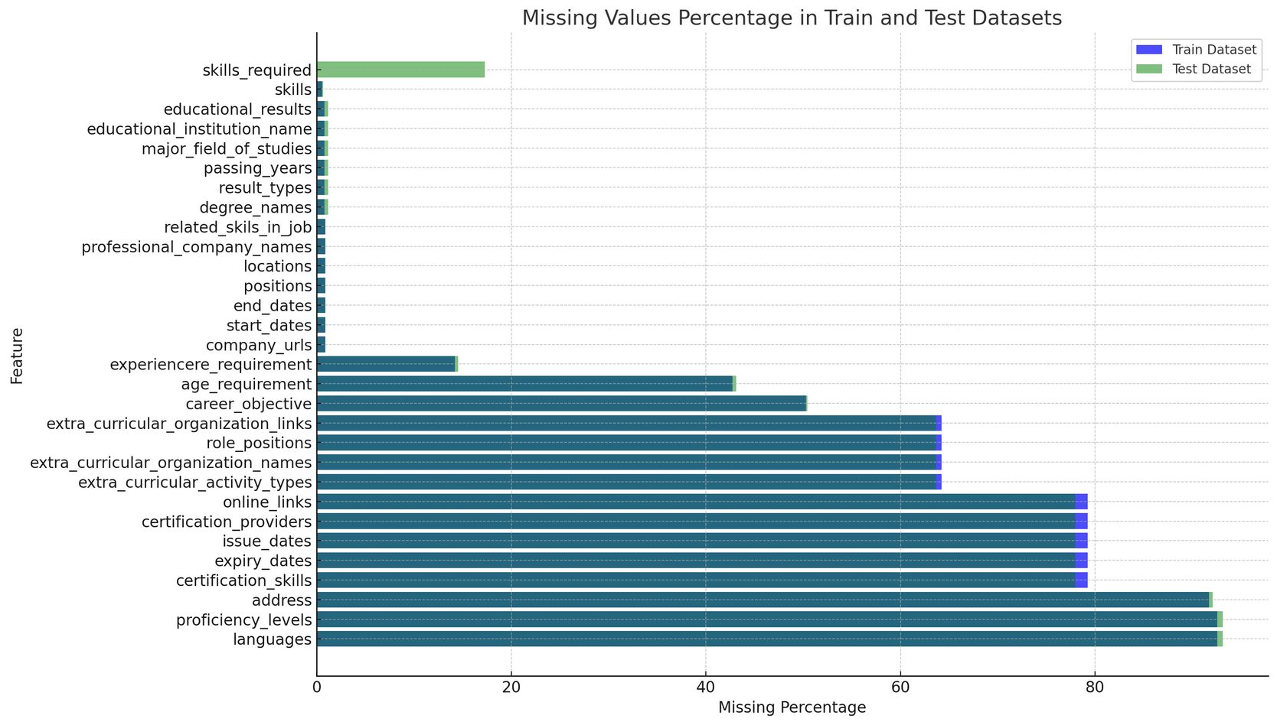
Percentage of Missing Values

Slide 9
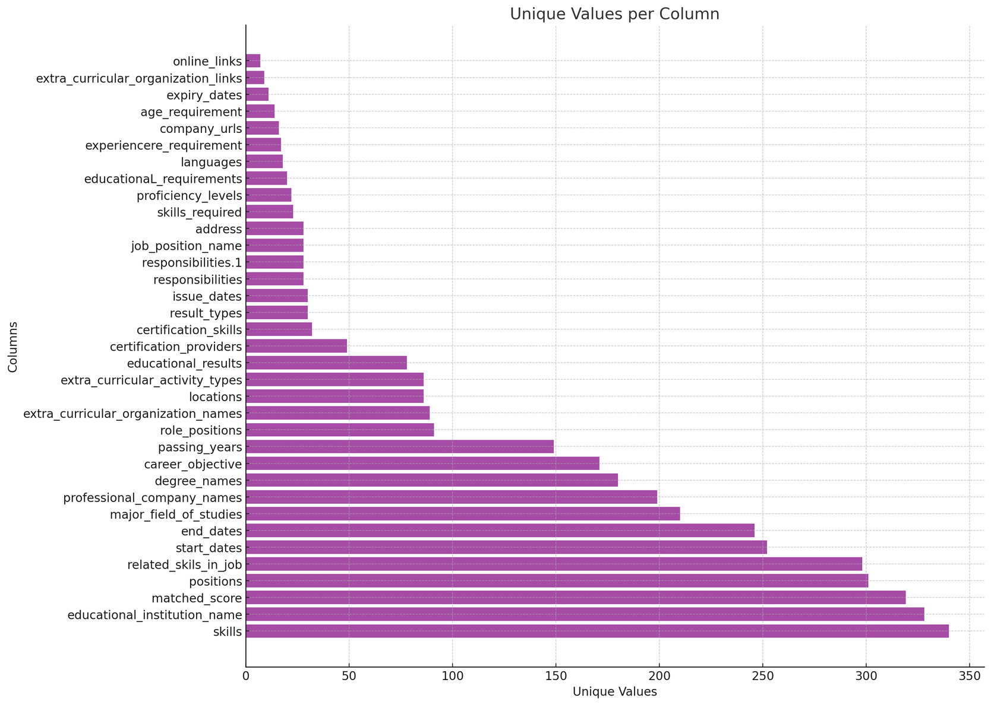
Analysis of Unique Values

Slide 10
Correlation Matrix for Numerical Features

Slide 11
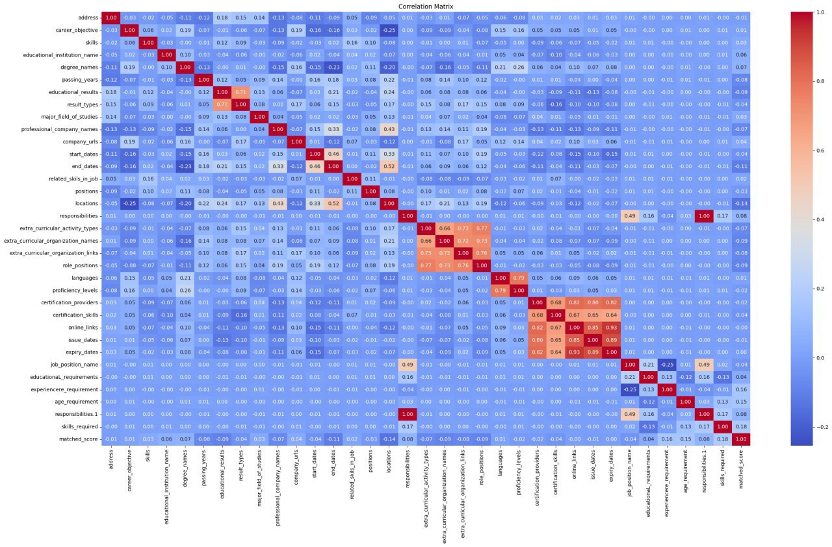

Slide 12
Job Fit Analysis System

Slide 13

Components
TextProcessor
Text feature processing
Feature Engineering
Feature creation and transformation
Model Training
LightBGM
Hyper-Parameter Tuning Trial & Error

Slide 14

Data Pipeline
Text Processing
Feature Engineering
Model Training
Prediction

Slide 15

Text Processing
Raw Text Data
Dense embeddings outperform sparse vectors (e.g., one-hot encoding) in preserving contextual relations between words.
Text Cleaning
TF-IDF Vectorization
Citation
Count Vectorization
Chiu, B., Crichton, G., Korhonen, A., and Pyysalo, S., 2016. How To Train Good Word Embeddings For Biomedical NLP. pp.166-174.
SVD Dimension Reduction
Processed Features

Slide 16



Feature Engineering
Numeric Features:
Extracted years of experience, education scores, and weighted composites.
Categorical Encoding:
One-hot and label encoding for categorical fields.
Text Features:
Used the TextProcessor to transform unstructured text fields into actionable insights.

Slide 17
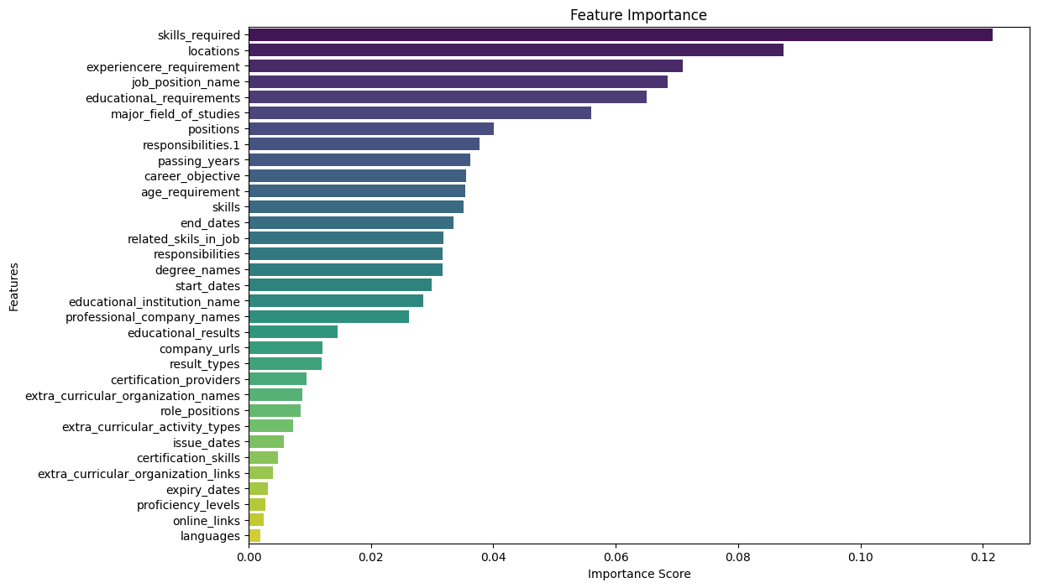
Feature Engineering
Raw Text Data
Numeric Feature Extraction and Scaling
Text Embedding
Categorical Encoding
Final Feature Set

Slide 19
Feature Importance Analysis
Key Insights
Top features like skills_required, locations, and experience_requirement had the highest importance scores.

Slide 20
Feature Importance Analysis
Relevance
These scores informed the weights assigned to key features for creating a composite feature.

Slide 21
Feature Weights
skills_required
locations
experience_requirement
job_position_name
educational_requirements
major_field_of_studies
responsibilities.1
0.12
0.10
0.09
0.08
0.07
0.06
0.05
passing_years
career_objective
skills
age_requirement
start_dates
responsibilities
0.05
0.04
0.03
0.03
0.02
0.02

Slide 22
Feature Importance Analysis
Impact
The engineered features formed the foundation for training high-performance predictive models.

Slide 23
Model Selection & Optimization

Slide 24
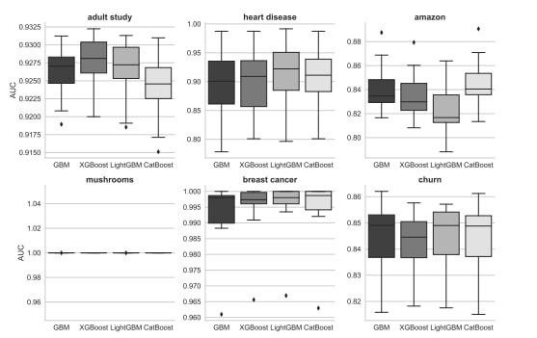
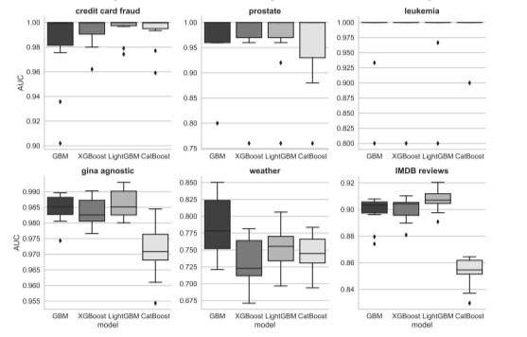
Benchmarking for Choosing LightGBM
Fig: AUC distributions across 12 datasets with TPE tuning
(Ref: Florek, Piotr, and Adam Zagdański. "Benchmarking state-of-the-art gradient boosting algorithms for classification." arXiv preprint arXiv:2305.17094 (2023))

Slide 25
Benchmarking for Choosing LightGBM
Fig: AUC distributions across 6 datasets with TPE tuning

Slide 26
Benchmarking for Choosing LightGBM
Fig: AUC distributions across 6 datasets with TPE tuning

Slide 27
Baseline Model
RandomForestRegressor for feature importance
Optimized Model
LightGBM with Optuna for hyperparameter tuning

Slide 28
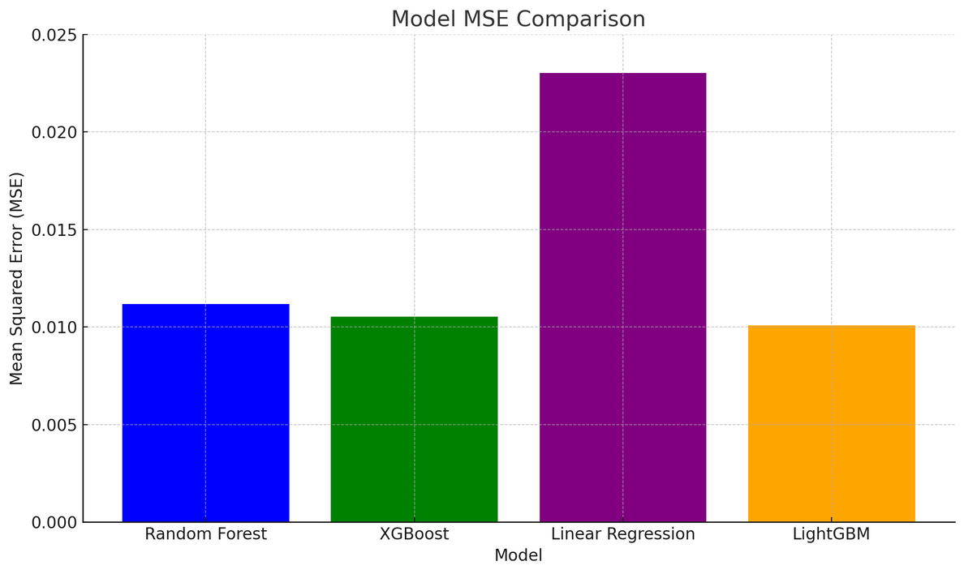
Model Testing
with Validation Set
RandomForrest
XGBoost
LinearRegression
LightGBM
0.011170369267873400
0.01053899568888147
0.023029894230111148
0.01008864010446075
Fig: Regression Model Comparison

Slide 29

Model Testing
with Validation Set
Best Model
LightGBM
MSE Ranking
LightGBM < XGBoost
< RandomForest
< LinearRegression

Slide 30
Model Testing
with Validation Set
Non-linear Capture
Tree-based model is better than Linear model.

Slide 31
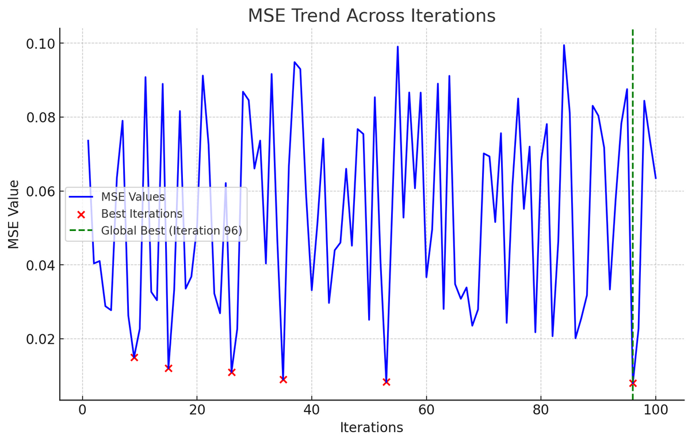
Tuning Hyperparameters
over the Epochs
Globally Best Iteration
96 (lowest MSE)
Locally Optimal Iterations
9, 15, 26, 35, 53

Slide 32
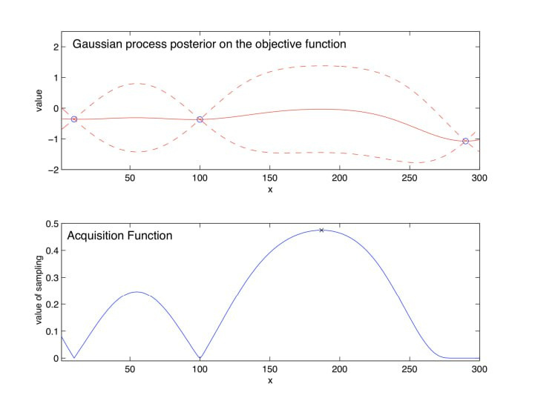
Tuning Hyperparameters
over the Epochs
The figure shows Bayesian Optimization using a Gaussian Process and Acquisition Function
(Ref: Frazier, Peter I. "A tutorial on Bayesian optimization." arXiv preprint arXiv:1807.02811 (2018).)

Slide 33
Fig: Bayesian Optimization Using a Gaussian Process and Acquisition Function

Slide 34
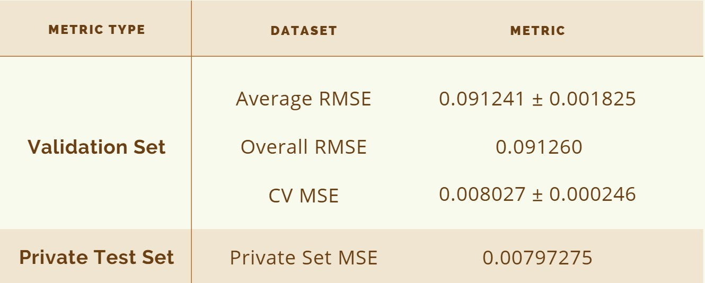
Findings
Prediction accuracy chart of our trained model -

Slide 35
Key Takeaways
Feature Engineering | Composite Features Text Processing Experience/Education
Data Handling | Missing Values Rare Categories
Model Optimization | Optuna LightGBM (GPU T4 x 2)

Slide 36
Key Takeaways
Evaluation Strategy | 5-Fold CV Ensemble Predictions
Regularization | Early Stopping Feature Importance
Preprocessing | Encoding Scaling/Normalization

Slide 37
Future Works & Scopes of Improvement
Advanced Feature Engineering
Manual Investigation & Sub-feature flattening
Ensemble Methods
(Ref: Opitz, D., & Maclin, R. (1999). Popular ensemble methods: An empirical study. Journal of artificial intelligence research, 11, 169-198)

Slide 38
Future Works & Scopes of Improvement
Combine multiple models by stacking and voting
Regularization Techniques, such as applying methods like L1 or L2 regularization
(Ref: Jaiswal, S., Mehta, A., & Nandi, G. C. (2018, June). Investigation on the effect of L1 an L2 regularization on image features extracted using restricted boltzmann machine. In 2018 Second International Conference on Intelligent Computing and Control Systems (ICICCS) (pp. 1548-1553). IEEE.)

Slide 39




Team Members
H.M. Shadman Tabib
Suhas Abdullah
Md. As-Aid Rahman
Ishrak Adit
All members are currently third-year students at Department of CSE, BUET

Slide 40
Thank you

Slide 41
Any questions..?

